Slide 1
A modular IT literacy course for the Internet era
Skills: none
Concepts: definition of IT literacy, evolution of IT literacy, variation in IT literacy courses, teaching module format, scalability of modular projects (the Wikipedia effect)
This work is licensed under a Creative Commons Attribution-Noncommercial-Share Alike 3.0 License.
Notes:
IT literacy courses and curriculum date back to the 1960s at Dartmouth.
The curriculum has been revised over the years as new platforms for developing and delivering applications emerged.
Today, many students take IT literacy courses, but the curricula vary somewhat as a function of the student’s major field.
I have developed a set of modules, from which a customized course or a few modules to supplement a textbook can be selected.
The modules have a uniform format that I will describe.

Slide 2
Where does this topic fit?
Internet concepts
Applications
Technology
Implications
Internet skills
Application development
Content creation
User skills
Notes:
This presentation does not fit within the course, it is a meta-presentation about the course.

Slide 3
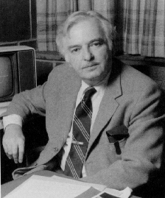
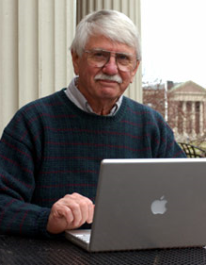
John Kemeny and Thomas Kurtz
Notes:
John Kemeny and Thomas Kurtz offered the first ever IT literacy class at Dartmouth College in the early 1960s.
They believed that every liberally educated undergraduate needed knowledge of computers and information technology, regardless of their major.
The US National Science Foundation agreed, and funded their work.

Slide 4
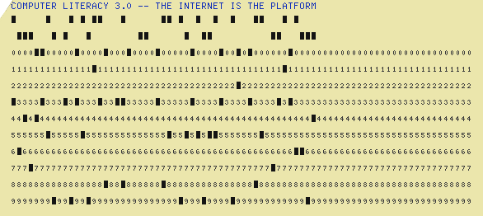
Batch processing
Notes:
Early computers worked on jobs submitted in punched cards.
Programmers and users did not directly interact with the computer.
They dropped decks of punch cards off with computer operators, who fed jobs to the computer in batches.
They picked up the results after the job had run – typically a couple of hours after submitting it.
IT literacy was difficult to teach during the batch processing era because computers were very expensive and difficult to use.

Slide 5
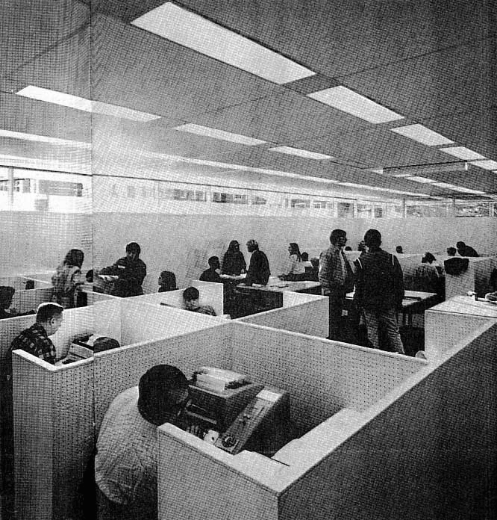
Dartmouth public terminal room
Notes:
Timesharing, a new way to develop and deliver applications was invented in the late 1950s and early 1960s.
With timesharing, programmers and users interacted directly with the computer through terminals.
Kemeny and Kurtz realized that timesharing made an IT literacy course practical.
They built a student computer lab at Dartmouth, invented the BASIC programming language to illustrate algorithmic thinking and began teaching IT literacy to liberal arts students.

Slide 6
IT Literacy
The Skills and concepts needed for success as a student and after graduation as a professional and a citizen.
Notes:
IT literacy consists of the skills and concepts needed for success as a student and after graduation as a professional and a citizen.
This is a paraphrase of Kemeny and Kurtz’ definition of IT literacy.

Slide 7
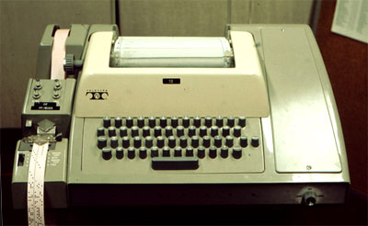
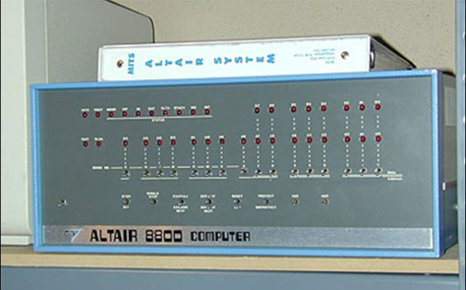
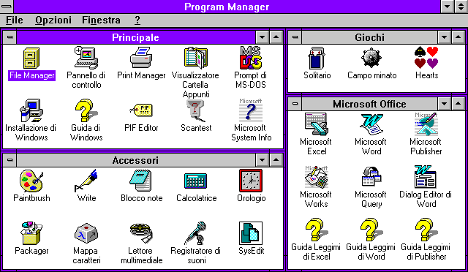
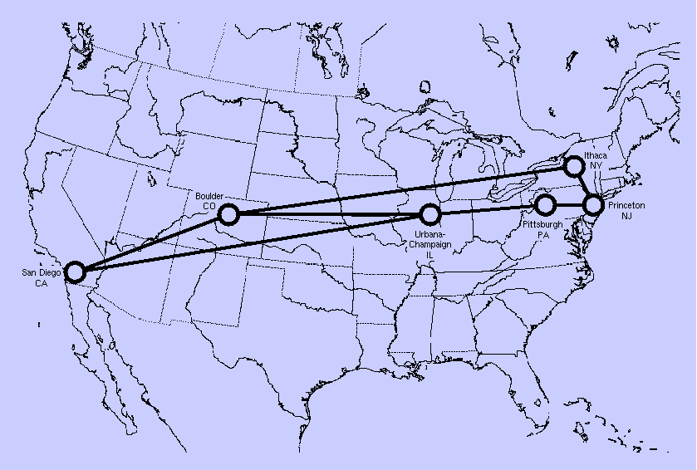
IT literacy evolution
Timesharing
PC
Windows
Internet
Mobile ?
Notes:
The IT literacy curriculum has changed as new platforms for developing and delivering applications became available.
With the advent of timesharing, Kemeny and Kurtz developed a curriculum that included hardware and software concepts, a taste of programming and algorithmic thinking, and a survey of applications and social implications.
With the advent of the personal computer, productivity applications replaced programming.
Office became the de facto productivity applications with the emergence of Windows.
The Internet era requires a new set of skills and concepts today.
Ubiquitous portable devices may drive the next generation IT literacy curriculum.

Slide 8
The definition remains the same
The Skills and concepts needed for success as a student and after graduation as a professional and a citizen.
Where are we today?
Notes:
The relevant skills and concepts have changed as the dominant platform has changed, but the definition remains the same.
How do we teach IT literacy and which skills and concepts are we teaching today?

Slide 9
At CSUDH today
CS
CIS
5 sections
5 sections
Notes:
IT literacy is offered widely – many students, making it a high-impact course.
Ten sections of IT literacy were offered on my campus this semester.
Those sections probably enrolled around 400 students, and we are one of the smallest CSU campuses.
On our campus, two competing departments offer ten sections of introductory IT courses.

Slide 10
Not exactly the same course
CIS
CS
Notes:
The courses offered by the two departments are not identical, but there is considerable overlap.
But, there is still more variation.

Slide 11
An IT department
IT
majors
Other
majors
Notes:
The two departments serve their majors and also offer service courses for students in other departments.
On our campus, the CIS department covers their majors as well as all other business students.
The CS department covers their majors and offers a service course for education.
The requirements of the IT majors and others are not the same.
For example, there are seven topic modules dealing with TCP/IP.
An instructor teaching IT literacy for IT majors or an introduction to data communication, would cover all seven modules, while an instructor teaching IT literacy for general business students might include only the TCP/IP overview module.
And the situation is still more complex.

Slide 12
Different majors
IT majors
Others
Notes:
Today, everyone is a creator and a manipulator of information.
Students in every field – art, music, literature, journalism, the sciences, and so forth all require somewhat different IT literacy foundations.

Slide 13
Integrated versus distributed
Notes:
Here is another variation on the theme.
Some schools prefer to present IT literacy as a single, lower division course, others spread it through the curriculum.
For example, a business school might want to include an introduction to spreadsheets as part of a lower division accounting or finance class or and chemistry or biology might want to include a bit of image processing in their introductory courses.

Slide 14
My solution
.
.
.
Notes:
This is my solution for dealing with complexity – can you figure this slide out?
Pause and give it a try before going on.

Slide 15
Topic modules
Complete
course
.
.
.
Supplement
Notes:
My solution is a set of modules.
A complete course can be assembled from a subset of those modules.
Or an existing course can be augmented with a smaller subset.
For example, and English class might use a few modules on writing for the Internet and a journalism class a few modules on audio recording and editing.

Slide 16
Unique URLs
http://cis275topics.blogspot.com/xxx
also on Merlot
http://www.merlot.org/
Notes:
Each module has a unique URL.
We can easily define an entire course by compiling a list of modules or include a link to a single module to supplement a course.

Slide 17
The Wikipedia effect
Notes:
In addition to allowing us to serve a variety of student needs, modular projects scale easily.
A community of faculty and students can form around the overall project or as little as one module.
Since each topic module is a blog post with a unique URL, there is a built-in mechanism for comments and discussion.
Wikipedia provides and example of the scalability of modular projects.
While some contributors concern themselves with the overall encyclopedia, others focus on one or a few articles.

Slide 18
Skills and concepts needed for success as a student and after graduation as a professional and a citizen.
Skills
Application development
Content creation
User skills
Concepts
Applications
Technology
Implications
Notes:
So far, I have about 90 topic modules, organized as shown here.
Each is roughly equivalent to a section in a textbook chapter – we cover around 6 per week.
I am continuously adding new modules and revising others after using them.
Let’s look at the format of a typical topic module.

Slide 19
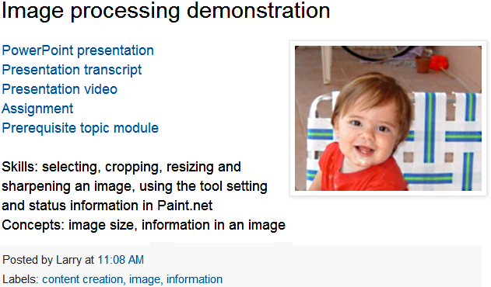
A topic module
Notes:
Here is a sample topic module.
Each topic module has an original PowerPoint presentation.
They also have lists of the skills and concepts covered, keyword tags (labels), transcripts, assignments and links to pre-requisite modules.
I’m adding narrated videos as time allows and creating a new module or two every week.

Slide 20
Uniform format
Head
Title, skills and concepts
Place in the class outline
Body
…
Foot
Summary
Self-study questions
External resources
Notes:
Each PowerPoint presentation has the same format.
The header consists of two slides.
One lists the title and the skills and concepts covered in the presentation; the second shows where the module fits within our class outline.
The Footer is three slides -- a summary, self-study questions and links to external resources.

Slide 21
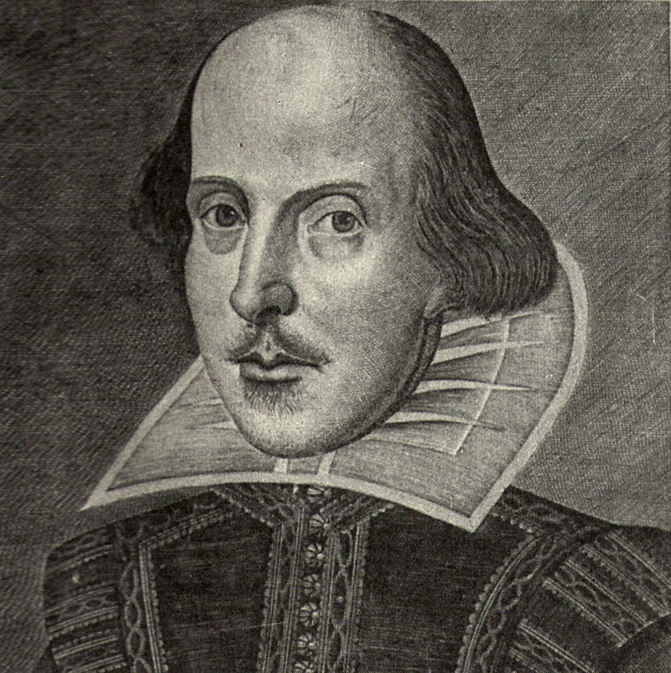
The notes are a script
Notes:
Each slide also has text notes.
The notes serve as a script for the narrated video of the presentation.

Slide 22
Narrated videos
Notes:
Using the script, I produce a video with a linked table of contents on the side.
Students can watch the video using the normal video controls or they can jump directly to any narrated slide by clicking its entry in the table of contents.
Note that there are no video transitions between the slides and no live video of me talking.
That keeps the file sizes small.

Slide 23
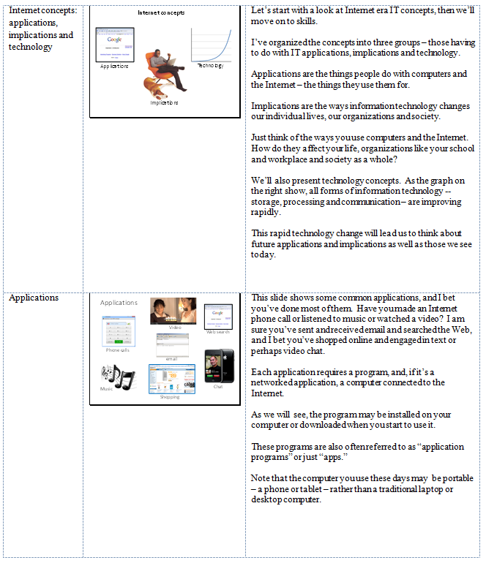
Transcripts
Notes:
I also use the script notes to prepare a presentation transcript.
As shown here, the slides and notes are shown side-by side.
This format is useful for a student actively studying the presentation as opposed to passively watching it in class.
Students can print these out, creating an informal, focused textbook.

Slide 24
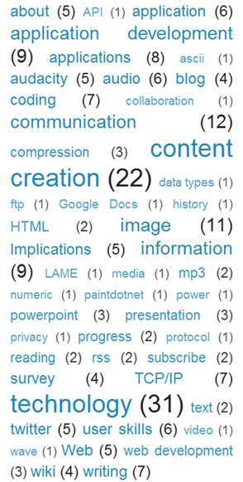
Search and retrieval
Notes:
Our implementation is simple.
We use two blogs as databases – one for the topic modules, a second for the assignments.
In addition to being easy and free, we can use the blog’s text search and keyword tagging feature to retrieve modules.
As shown here, seven of the modules are tagged with the key word TCP/IP, making it easy to retrieve and review them.

Slide 25
Which skills and concepts?
Internet concepts
Applications
Technology (processing, storage and communication)
Implications (for individuals, organizations and society)
Internet skills
Application development
Content creation (written, image, audio, video)
User skills
http://skillsandconcepts.wikispaces.com/
Notes:
Here is a somewhat more detailed version of my class outline.
How should the outline be changed?
Which skills and concepts do you think should be included in the IT literacy curriculum?
Post and discuss your views on this wiki.

Slide 26
Summary
.
.
.
Notes:
We reviewed the evolution of IT literacy courses from the 1960s to the present day, and saw that today IT literacy is a high-impact course taken by many students.
There is a lot of overlap, but the concepts and skills required by students with different majors vary.
A modular approach allows us to tailor the course to different majors.
Modular projects also scale well, since a community can form around the project as a whole or a single module.
We also reviewed the structure of the set of modules I am developing.

Slide 27
Self-study questions
List three important skills that every undergraduate student needs.
List three important concepts that every undergraduate student should acquire.
Review the topic modules and select three which you feel are not necessary.
Review the topic modules and select three you wish you had been taught early in your undergraduate studies.

Slide 28
Resources
John Kemeny worked on the Manhattan Project, was Einstein’s mathematics assistant as a student, and was Professor of mathematics and President of Dartmouth College: http://en.wikipedia.org/wiki/J._Kemeny
Thomas Kurtz studied under John Tukey at Princeton, has been professor of math, computer science and Computer Information Systems and computer center director at Dartmouth: http://en.wikipedia.org/wiki/Thomas_Eugene_Kurtz
Kemeny, John G., and Kurtz, T. E., "Dartmouth Time Sharing, “Science, Vol 162, No 3850, October 11, 1968, pp 223-228, http://dtss.dartmouth.edu/sciencearticle/. The article describes the project, including the rationale for computing being part of the liberal arts and the use of the system in and out of the curriculum.
John G. kemeny and Thomas E. Kurtz, “The Dartmouth Time-Sharing Computing System,” Final Report to the National Science Foundation), June 1967: http://www.eric.ed.gov/PDFS/ED024602.pdf
History and description of the Dartmouth timesharing project: http://dtss.dartmouth.edu/history.php
Twigg, Carol A., The One Percent Solution, Educom Review, Volume 30, Number 6, November/December 1995: http://net.educause.edu/apps/er/review/reviewarticles/30616.html. The article suggests a strategy of focusing design and development effort on high-enrollment courses.
Press, Larry, Tomorrow's Campus -- Information Processing at Tomorrow's University, Communications of the ACM, Vol 37, No 7, pp 13-17, July, 1994, http://som.csudh.edu/fac/lpress/articles/uart.htm. The article argues for modular courseware rather than monolithic text books.
IT literacy topic modules: http://cis275topics.blogspot.com/.
IT literacy assignments: http://cis275assignments.blogspot.com/.
About the IT literacy electronic text: http://cis275topics.blogspot.com/2010/09/about-our-electronic-text.html
Using the IT literacy electronic text: http://cis275topics.blogspot.com/2010/07/about-cis-275-topic-modules.html.
IT literacy course background: http://computerliteracy3.blogspot.com/.
IT literacy course content summary: http://cis275topics.blogspot.com/2010/07/course-overview.html.
This course on Merlot: http://www.merlot.org/merlot/materials.htm?userId=24465.

Slide 29
The modules on Merlot: http://bit.ly/qxiXjF
About our electronic text: http://bit.ly/fSxEYP
Using the topic modules: http://bit.ly/nzp9BD
Assignment blog: http://cis275assignments.blogspot.com/
Topic module blog: http://cis275topics.blogspot.com/
This presentation: http://bit.ly/oc7G1K
Me on Google+ http://bit.ly/ogn5n6

Slide 30
Which skills and concepts?
Internet concepts
Applications
Technology (processing, storage and communication)
Implications (for individuals, organizations and society)
Internet skills
Application development
Content creation (written, image, audio, video)
User skills
http://skillsandconcepts.wikispaces.com/
Notes:
Discussion …

