Slide 1

Learning Outcomes Made Easy
Using the Best Tools
Jeffrey D. Keith, Ph.D.
J. Kelly Flanagan, Ph.D.
Russell T. Osguthorpe, Ph.D.
Danny R. Olsen, Ph.D.
Tom Mallory
Jeff Fox, Ph.D.
Brigham Young University, Provo UT

Slide 2
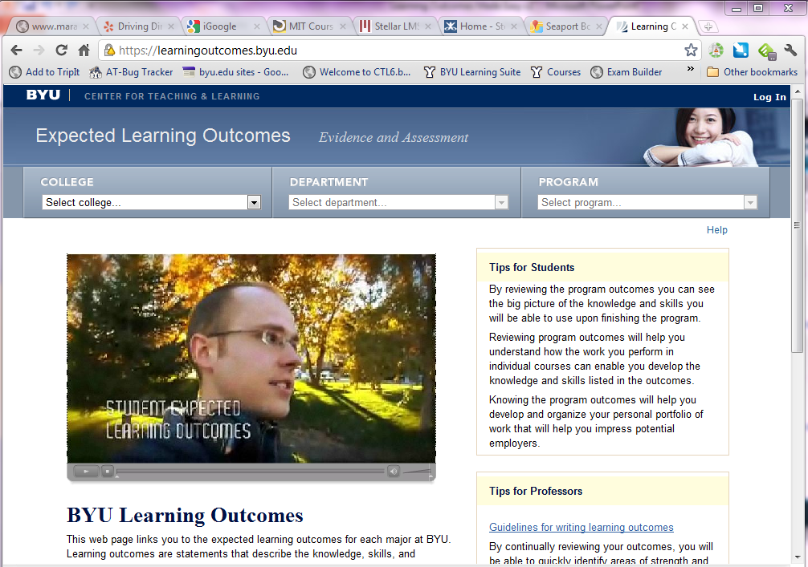
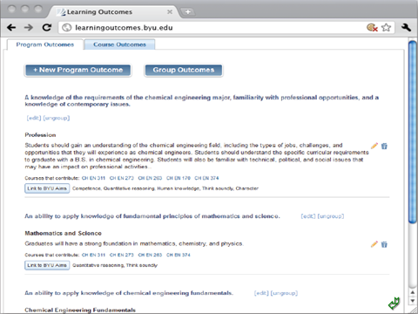

Slide 3

BRIGHAM YOUNG UNIVERSITY
        11 Academic Colleges
56 Academic Departments
400 Degree Programs
1,600+ Faculty
8,000+ Courses
33,000+ Students
Carnegie Classification: Research University (High Research Activity)
Northwest Commission on Colleges and Universities
30 Specialized Accrediting Organizations
Notes:
Common requirements embedded within the current accreditation standards of most if not all accrediting bodies include with some variation require institutions to: 1) publish expected learning outcomes for each of their programs, 2) provide evidence that the expected learning outcomes are realized by students, and 3) demonstrate how such data collection and analyses leads to continuous improvement of student learning, the curriculum, and the university. This is a significant challenge, especially for large schools with many students. This is a process in perpetuity in the quest for increased learning, not something that is completed and shelved, game, set, match. Existing disciplines change, evolve, and reinvent themselves on an ongoing basis as new disciplines are born. Just as technology regularly reinvents itself, what is taught, how it is taught and the associated priority regularly change. Clearly it’s a lot to manage that requires ongoing attention. It’s essential to include students in the loop to improve a clearer alignment of expectations between faculty and students and between teaching and learning.
Brigham Young University (BYU) serves over 30,000 students across 12 colleges and 56 departments offering over 400 degree-granting programs. During BYU’s recent decennial regional accreditation emphasis on assessment strategies and learning outcomes accountability was appropriately far-reaching and has generated extensive response across the university community. This paper profiles BYU’s recent efforts in the quest for a deepened culture of assessment in the pursuit of increased learning and ongoing improvement. This paper illustrates 1) obstacles and challenges, 2) innovative strategies—some technological—employed to address the obstacles and challenges, and 3) current and future strategies for improved success.

Slide 4







U.S. Regional Accreditors
Notes:
List of regional accreditors
The following are the regional accrediting agencies for educational institutions in the United States:^{[4][5]}
Middle States Association of Colleges and Schools - Educational institutions in New York, New Jersey, Pennsylvania, Delaware, Maryland, the District of Columbia, Puerto Rico, and the US Virgin Islands, as well as schools for American children in Europe, North Africa, and the Middle East.
New England Association of Schools and Colleges - Educational institutions in the six New England states (Connecticut, Maine, Massachusetts, New Hampshire, Rhode Island, and Vermont).
North Central Association of Colleges and Schools - Educational institutions in Arkansas, Arizona, Colorado, Iowa, Illinois, Indiana, Kansas, Michigan, Minnesota, Missouri, North Dakota, Nebraska, Ohio, Oklahoma, New Mexico, South Dakota, Wisconsin, West Virginia, and Wyoming.
Northwest Accreditation Commission for primary and secondary schools and
Northwest Commission on Colleges and Universities for postsecondary institutions in Alaska, Idaho, Montana, Nevada, Oregon, Utah, and Washington.
Western Association of Schools and Colleges - Educational institutions in California, Hawaii, Guam, American Samoa, Micronesia, Palau, and Northern Marianas Islands.
Southern Association of Colleges and Schools - Educational institutions in Virginia, Florida, Georgia, Kentucky, Louisiana, Mississippi, North Carolina, South Carolina, Alabama, Tennessee and Texas

Slide 5
Assessment Charge
Colleges and universities
across the country are being asked to:
Publish expected learning outcomes for all of their courses and programs
Provide evidence that the expected learning outcomes are realized by students
Demonstrate how such data collection and analyses leads to continuous improvement of student learning, the curriculum and the university

Slide 6
Why “Student Learning Outcomes”?
Ethics: Assessment should ultimately (first and always) be about student learning
Student major selection
Aligning institutional, department goals
Student “take-aways”
Pressure:
  Stakeholders
  Accrediting entities
  Government agencies
  Employers
Notes:
“All of this focus, of the media, of quality assurance and of institutions, is on assessment as measurement…We should design assessment, first, to support worthwhile learning…(Gibbs and Simpson 2004)
“…if higher education is serious about promoting a(n) (assessment) culture that is sensitive to student needs and dedicated to the development of student success, it will strive to align institutional (program) and institutional expectations, connect services that are valuable to students, enrich student’s development through viable learning opportunities, and monitor student achievement of goals through assessment of learning outcomes, which allows them to see how what they do contributes to the overriding goal of student success. Indeed, if colleges are to be successful in fostering student success, it must be everyone’s business…student success is something we make happen.” (Kramer, G. 2007)
“Assessment is the systematic collection, review, and use of information about educational programs undertaken for the purpose of improving student learning and development.” (Palomba and Banta, 1999)
On the surface few would argue that the reason we have institutions of higher education is to facilitate learning. This sounds simple enough, however applied models of assessment and accountability are pushing for evidence of increased levels of learning to validate the tremendous costs most of which are on the rise. Pressure is surfacing from multiple directions that include 1) national educational entities, 2) regional accrediting bodies, 3) discipline-specific specialized accrediting entities, 4) funding agencies, 5) key stakeholders—students, employers, parents, etc. Expected learning outcomes are the foundation upon which all targeted learning at the course and program levels are based.

Slide 7
What are Student Learning Outcomes?
Definition: Statements defining what students should know, understand and/or be able to do as a result of their learning experiences in a degree program
  Cognitive (knowledge)
  Behavioral (skills)
  Affective (attitudes)
Assessment: What counts as evidence that a given level of competence has been achieved.
Clear and assessable statements of the “essential and enduring knowledge, abilities, and attitudes or dispositions” that enable a learner to apply what he or she has learned to situations encountered in the real world.

Slide 8
Direct & Indirect Evidence
DIRECT MEASURES
Imbedded performance assessment mapped to learning objectives
Course and homework assignments
Exams, quizzes
Standardized tests
Term papers, reports
Research projects
Capstone projects, senior theses, exhibits or performances
Pass rates, scores on licensure, certification, area tests
Rubric scores
INDIRECT MEASURES
Course evaluations
Alumni questionnaire data
Senior survey data
National Survey of Student Engagement data
Employer surveys
Graduate school placement rates
Department exit interviews
Focus group interviews with students, faculty, etc.
Job placement
Registration or course enrollment information
Notes:
Guidelines for Assessing Learning Outcomes (See Student Learning Assessment, 2003)
There are many ways to assess learning outcomes—student learning. The characteristics of good evidence includes: a) both direct and indirect methods gathering data, and b) the appropriate use of quantitative and qualitative data. It is also good to understand the fundamental concepts of formative assessment, summative assessment, and benchmarking. It is good to have convergence from multiple sources and types of data when substantiating whether or not stated learning outcomes have been realized.
The concepts of direct and indirect methods of evaluating student learning are often confused with each other and with quantitative and qualitative forms of information. Each has its merits and drawbacks.
Direct evidence—demonstrates actual learning, performance based work that is reflected in an evaluation of something the student has actually done or produced (e.g. homework, tests, papers, standardized tests, performances, products, etc.).
Indirect evidence—non-performance based data that reveals characteristics associated with learning, but only implies that learning has occurred (e.g . self report survey data, senior survey data, alumni questionnaire data, job placement rates, satisfaction rates, etc.).
Questions to consider: How will each learning outcome be assessed; what evidence of student learning is most relevant for each learning outcome? What criteria will be used to evaluate this evidence? In other words, what constitutes student performance at an exceptional, acceptable, and unacceptable level?
Tips: Develop a strategy to systematically and routinely collect, store, and retrieve assessment evidence pertaining to each learning outcome. Use multiple kinds of assessments for each learning outcome including: direct outcomes, such as outcome-related course assignments, exams, and capstone course projects, as well as indirect outcomes, such as employer, alumni and senior surveys. (See Student Learning Assessments, 2003; Levels of Assessment, 2005; Taking Responsibility, 2004,)

Slide 9
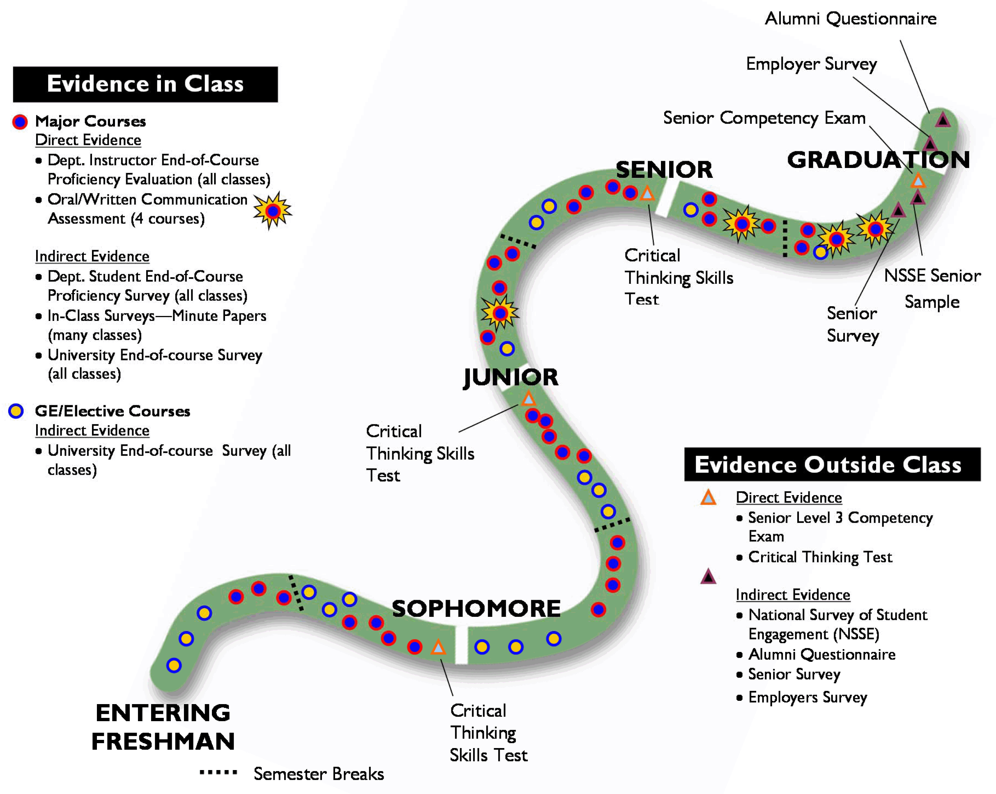
Evidences of Learning on Pathways to Graduation

Slide 10
University Goal Awareness
To Publish Course Level Learning Outcomes by August 31, 2011

Slide 11
Published, Mapped Course Outcomes
2011

Slide 12
Obstacles & Challenges
Culture of assessment disparity across campus.
Quality of stated “Expected Learning Outcomes”.
Obtaining faculty consensus within departments.
Faculty engagement in the process as part of the status quo without any extra compensation.
Moving from a faculty-centric to a student centric language of stated outcomes.
Appropriate channels of evidence—direct, indirect.
Demonstrating closing the assessment loop
Applied Technology—cost, time, scalability, usability
Notes:
Faculty Support
Many faculty are well on board with learning outcomes and assessment, however some feel that assessment, especially the kind that satisfies external accrediting bodies or other stakeholders external to the classroom is someone else’s job. They feel overworked, stressed, lacking the capacity for anything else to be put on their backs. Some honestly wonder what all the fuss is about and why giving grades isn’t sufficient. Others wonder what the use is. What difference does it really make anyway?
The art is convincing faculty who struggle with learning assessment that well structured and targeted assessment embedded in their pedagogy once established makes everything seamlessly integrated into the status quo—not a painful add on.
Evidence
Being able to adequately present evidence that intended learning outcomes have been achieved as demonstrated by students requires both direct and indirect evidence. Self reported assessments of learning collected via survey research have some value, but targeted performance based portfolios or standardized tests can take things to a higher level in outcome fulfillment validation. However, indirect survey based evidence is some aspects is the low hanging fruit at many institutions as they struggle in many disciplines in producing direct performance-based evidence. Commercial standardized tests are expensive have content limitations in the linkage to specified program goals in many disciplines and institutions. Indirect evidence of student learning can be handled for the most part at an institutional level; however the delivery of direct evidence is dependent upon the faculty at the discipline level. Developing a deepened culture of evidence takes years to establish and is an ongoing quest.
Closing the Loop
A commitment to the assessment of student learning requires a parallel commitment to ensuring its use. Perhaps the most difficult part of assessing student learning is the process of effecting change in teaching and learning as a result of information gained through assessment practices. It is pointless simply to only “do assessment”; the results of assessment activities should come full circle to have a direct impact on teaching and learning and the institution’s strategic plan to fulfill its mission (See Student Learning Assessment, 2003).
Changes in programmatic curricula as a result of assessment data do not happen automatically, as many can attest. However, if plans at the department level outline specific procedures for examining assessment results and implementing curricular revision, those changes are more likely to occur. Assessment results need to be shared and discussed by key stakeholders to develop hypotheses for resulting outcomes and recommendations for subsequent actions to be taken in the spirit of improved teaching and learning.

Slide 13
Design Goals
Ease of use
  Editing, viewing, and linking of program and course outcomes must be easy
Leverage existing IT web services
  Security, identity, course information
Data accessibility
  Existing university applications
    Course catalog, registration, syllabus builder
Notes:
All of these factors: Use SOA, De-couple data from application layer

Slide 14
Achieving Design Goals
Ease of use
  Usability
Leverage existing OIT web services
  University IT department adopted SOA
  SOA registry
Data accessibility
  Adopted a service model
    Common interfaces for interoperability
    Service registered in SOA registry
Notes:
To make sure that the Learning Outcomes application was easy to use we did extensive usability with both faculty and students. To help build faculty ownership we needed to make sure that is was easy for faculty to align program and course outcomes.

Slide 15
Learning Outcomes Web site
Syllabus
Builder
Course
Registration
Exams
Course
Catalog
Learning Outcomes Service
Discussions
Course
Evaluations
Program
Assessment
Tool
Course Assessment Tool
Course
Content

Slide 16
Challenges
Course Learning Outcome Outliers
  Certificates
  Emphases
  GE
  Service Course
Building a Learning Outcomes Assessment tool that meets disparate needs.

Slide 17




Slide 18
Faculty Involvement
http://www.youtube.com/byuctl#p/u/0/-oy6ztc1kq0

Slide 19
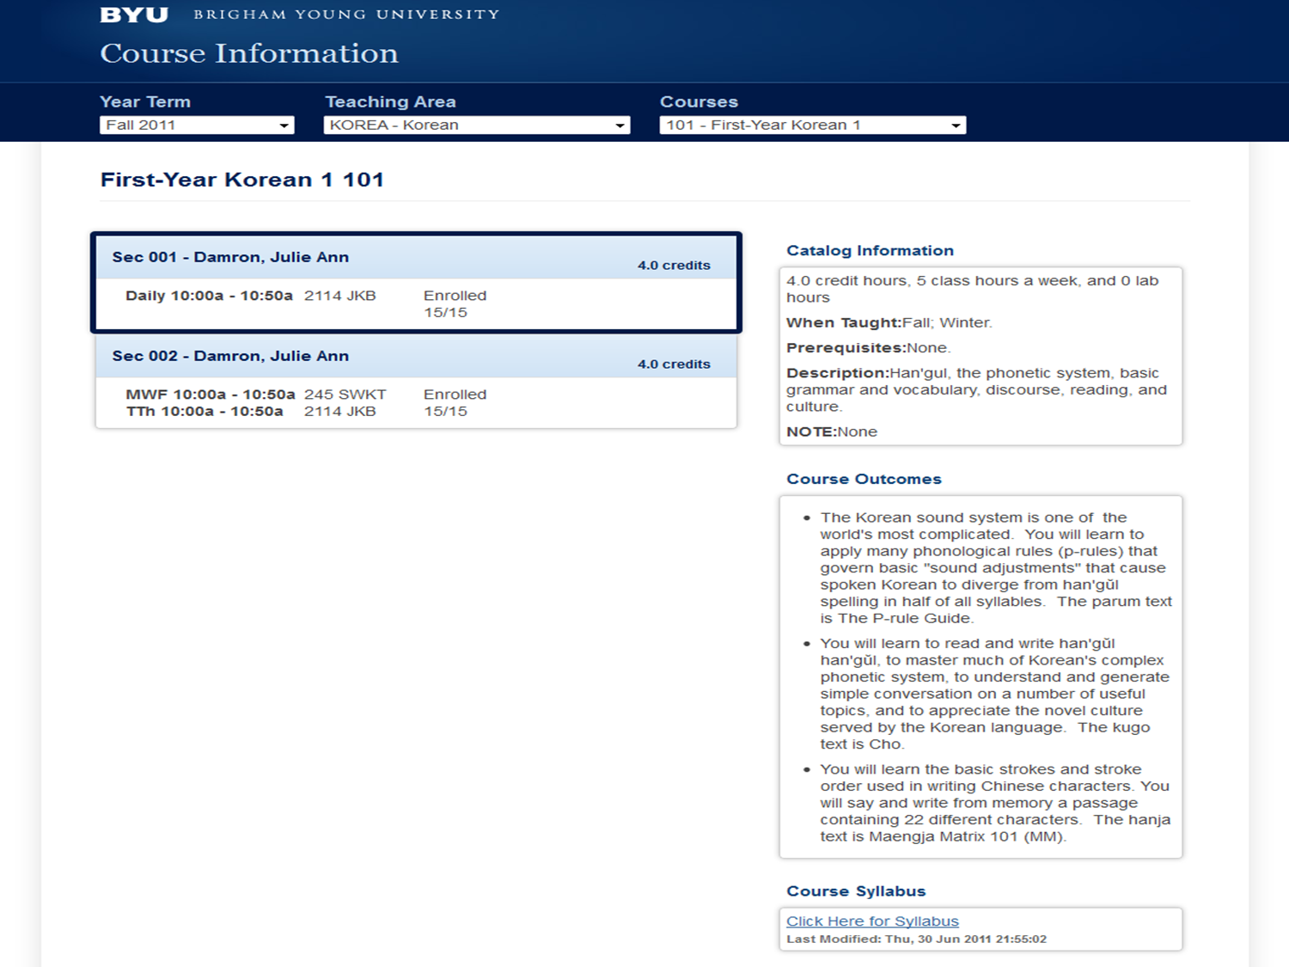

Course Catalog

Slide 20
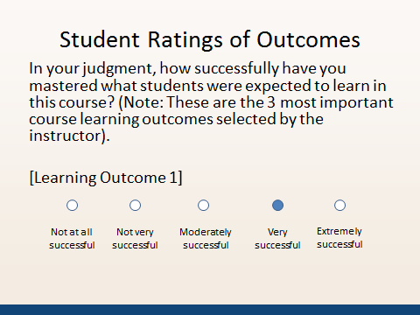
Course Evaluations

Slide 21

Program Assessment Tool
Just Beginning Design…

Slide 22
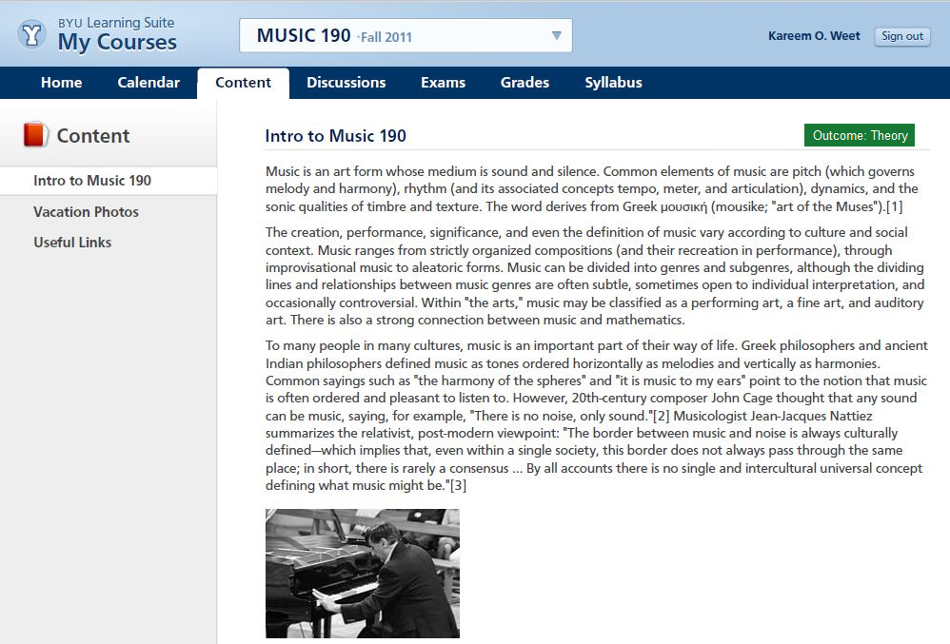
Course Content

Slide 23
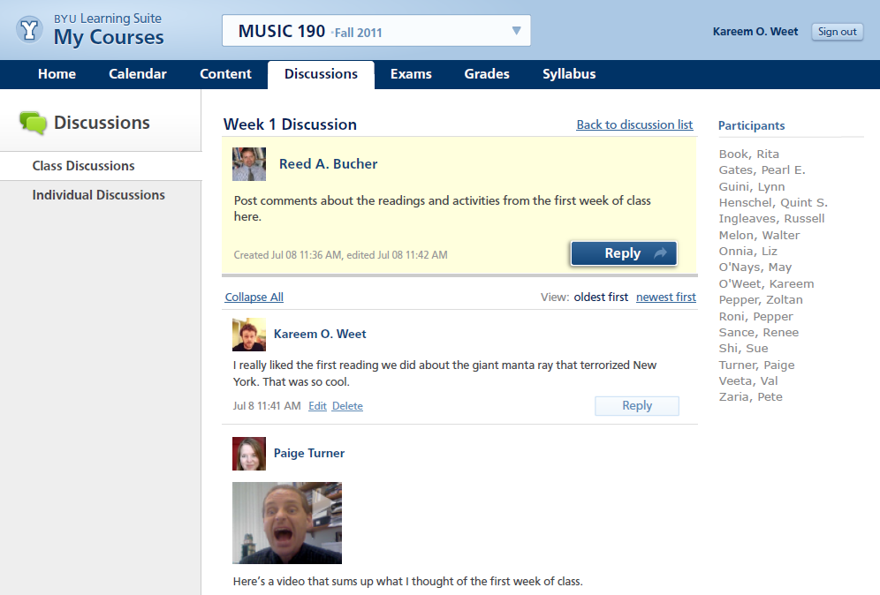
Discussions

Slide 24
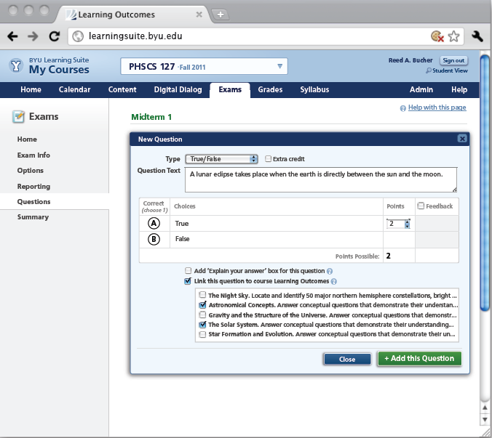
Exams

Slide 25
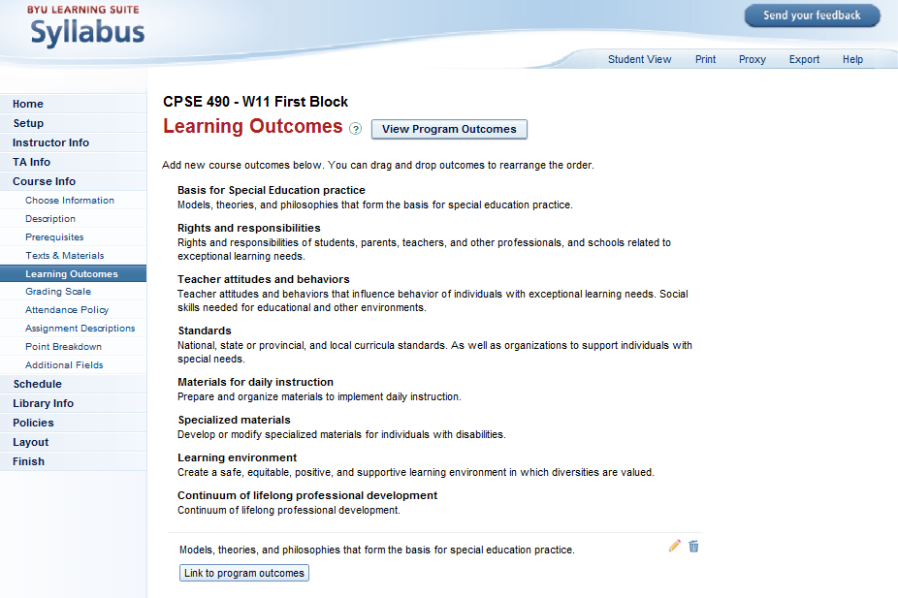
Syllabus Builder

Slide 26
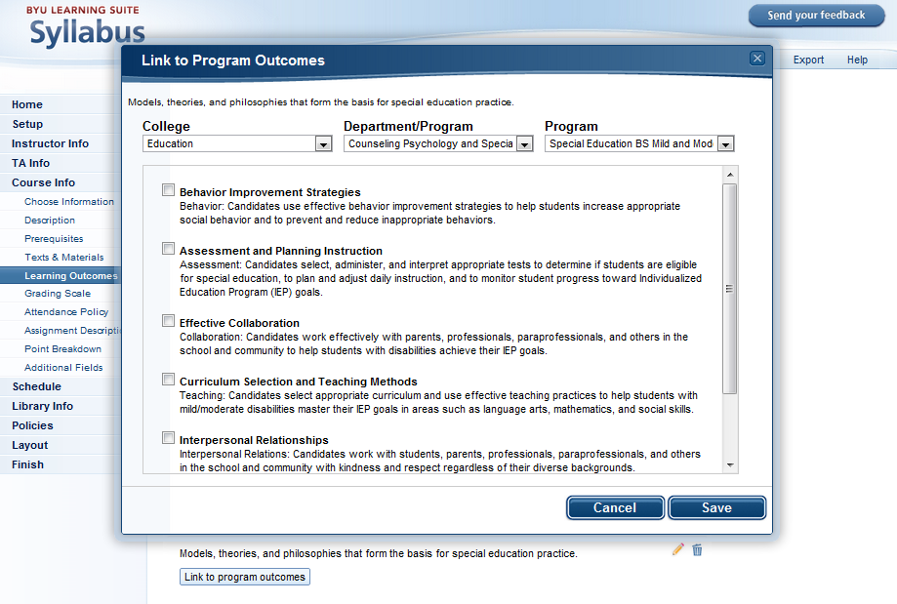

Slide 27
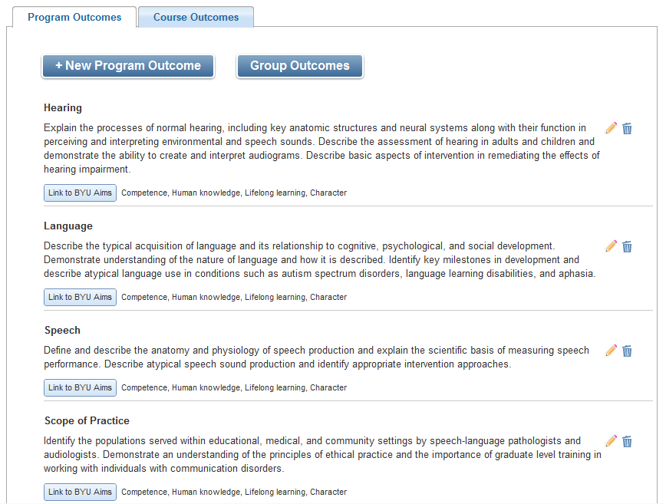
LO Website 1

Slide 28
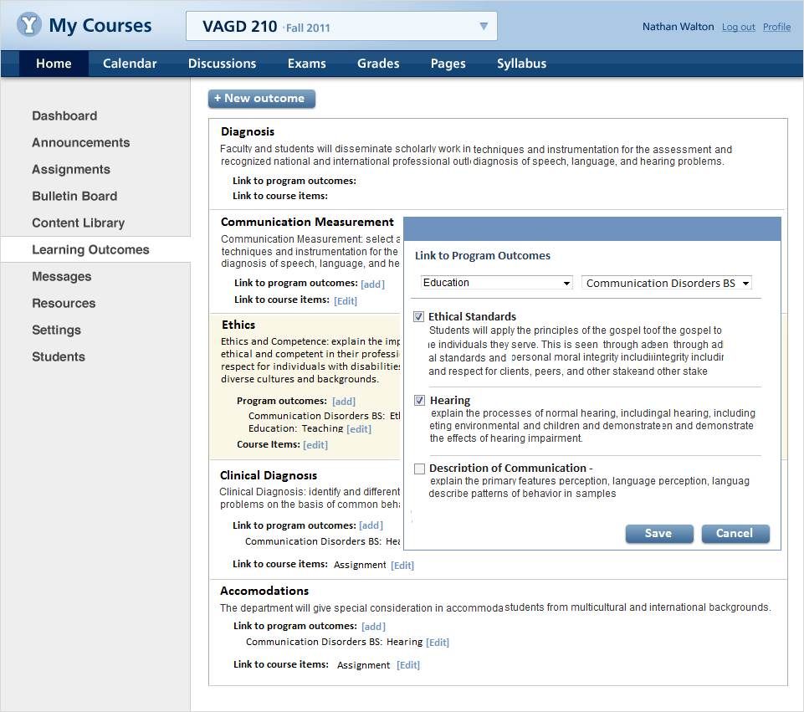

Slide 29
