Slide 1

Session 3: Building Community and Collaborating in Online Courses
Campus Technology 2011
M02 Principles and Practice for Engaging Learners

Slide 2

Common Questions about Grouping and Teaming
How do you group a class into two or three person teams quickly and easily?
What assignments work well? How do I/we structure assignments to ensure engagement? What is a practical step-by-step process for team assignments ?
What are barriers to group work? How do learners communicate easily and well in asynchronous learning?
What about grading and assessing? Learners don’t like to grade themselves or each other.

Slide 3
Assumptions, Beliefs and Questions about Collaboration
Getting Started
What do you know, think about group work?
Share an assumption, belief or experience with a colleague or two and then record/capture one on a “stickie.”
Quick
Association Response
Informal collaboration and grouping

Slide 4
Environment for Engagement
Grouping & Teaming Strategies
Informal small to medium groupings, collaborative work, peer review
Core Learning Principles
Active, involved, doing, zone of proximal development, personalizing
Online Best Practices
Presence, balanced dialogue, core content, continuous assessment
Shared experiences, overlapping goals, mutual support, trust and presence***
Elements of community
Who are the members of a course community? The learners and faculty mentor and any content assistants. Why does building a community support learners and learning?

Slide 5
What We Will be Doing with Community and Collaboration
Creating community
  What is community and why is it important?
  Phases of community
  Practices that support community
Collaboration Strategies
    First steps with grouping and teaming
    Forming, managing and assessing with collaboration groups
    Principles, practices and tips
    How do teaming practices fit with everything else?

Slide 6


Reminder —
Practices 1, 2, & 3
Be present at the course site
  Being there” for your students — your social, teaching and cognitive presence
Create a supportive online community where learners are responsible for each other
  Build and use community with learner support and dialogue
Develop a set of explicit expectations for your learners and for yourself
  Being very very clear regarding expectations and reinforcing core concepts, and teaching with discussion wraps and a weekly rhythm
Garrison
Anderson
Brookfield

Slide 7
Best Practice 2: Create a Supportive Online Course Community
Design a course with a balanced set of dialogues
  Faculty – learner; learner to learner; learner to resource
  Increases learning with “distributed thinking and practice”
Design elements for building community
  Getting acquainted and sharing goals
    Initial week forums for social presence and for cognitive presence
  Access, research, discuss content and creation activities collaboratively
  Collaborative work on problems, projects, products
  Peer review, support, feedback, consulting
Role of grouping and teaming

Slide 8
Best Practices - Phases of Engagement in a Course
 | Student Learner | Faculty Designer & Director
Phase 1 | Newcomer | Social & Cognitive negotiator
Phase 2 | Cooperator & Planner | Structural director
Phase 3 | Collaborator & Thinker | Facilitator
Phase 4 | Initiator/Partner & Doer | Community member & Challenger & Assessor
Adapted from Conrad, R. & Donaldson, J. Engaging the Online Learner
BP2 - Community

Slide 9
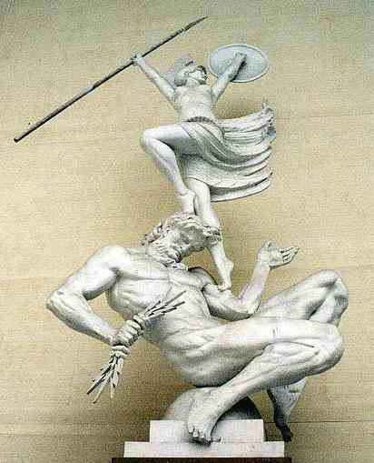
Three Phases of Community
Community doesn’t just happen, “full-blown”; it takes planning, time, engagement.
What are the behaviors of faculty and learners that support creating a community?

Slide 10

Becoming a Community
What is community?
  Core characteristics of a community
Stage 1 - Making friends
Stage 2 - Community acceptance (conferment)
Stage 3 - Stimulating and comfortable camaraderie
How does this work in a course environment?
  Faculty behaviors and actions
  Learner behaviors and actions
Brown, Ruth (2001) The Process of Community-Building in Distance Learning
http://sloanconsortium.org/sites/default/files/v5n2_brown_1.pdf

Slide 11


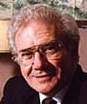
From the Literature on Community…
Support from people who "share common joys and trials (C. Dede, 1996)
Sense of belonging, of continuity, of being connected to others and to ideas and values (Sergiovanni, T. J., 1994)
Acting within a climate of justice, discipline, caring, and occasions for celebration" (Boyer, E., 1995)
How do your learners demonstrate support for each other?

Slide 12
Core Characteristics of a Community
Characteristics or “core elements" of a learning community
  Sharing of visions, values, ideas
  Supporting one another in what they are doing, and working to learn?
  Sense of belonging and acceptance
  Being mutually responsible for learning within the community
What is your "top pick" characteristic for a learning community?

Slide 13
Stage 1 - Making friends
Building webs and threads of connections among the learners
What ideas and values do learners have in common? What ideas and values do they respect, if not share?
  Similar ideas, visions, thoughts
  Wishes, goals, areas of confusion
Moving from social to cognitive, intellectual sharing
  What do you really think and why?
What is collaborative learning? – “Interactive learning groups”
Barkley, Cross and Major (2005). Collaborative Learning Techniques.

Slide 14
How do you Make friends online?
How does it work? Do you need/want to be friends with everyone? How many learning “friends” work well?

Slide 15


First Week Forum: Getting Acquainted – Building Social Presence and Trust
Getting acquainted postings
    Opportunity to personalize and get to know other students and develop a “social presence”
      Pictures
      Sharing bios
      Sharing work, family, community interests
    Launching a “quick trust”
    Elevator, cocktail openings, but deeper
  A significant or favorite life experience related to the course to come

Slide 16
First Week Forum: Setting and Sharing Goals – Cognitive Presence
Customize learning goals – Develop a sense of “Cognitive presence”
Do I understand the learning outcomes of the course?
  What do the learning outcomes mean to me?
  How do I think that I will use the knowledge, skills, perspectives now and in the future?
    Arthur was preparing to become King.
  How will I personalize the learning outcomes?
    When I talk with my friends, family and other folks, how can I share what I am doing?
Who am I as a learner and why am I here?

Slide 17
Stage 2 - Community Acceptance (Conferment)
Requires a feeling of "sharedness"
  Often follows a " long, thoughtful, threaded discussion on a subject of importance after which participants felt both personal satisfaction and kinship." (Brown, 2001)
Similar to the feeling of satisfaction during or following "shared experiences"
  Taking time for exploration and confusion
Small teams or dyads can provide good beginnings…
How do you foster and encourage thoughtful discussions and "shared experiences?"

Slide 18


A Deeper look at Content for meaning
Shared experiences require content

Slide 19

Four Layers of Content
Core Concepts
and Principles
Core Concepts
and Principles
Applying Core Concepts
Problem Analysis and Solving
Customized and Personalized

Slide 20
Dimensions of Content
Prepackaged authoritative content**
  Textbooks and other purchased/subscribed content
Guided learning materials - Teaching Presence
  Faculty prepared
Interactive and spontaneous performance content
  Learner-generated, individually or as part of a team
This type of content is Increasingly important
www.campus-technology.com/print.asp?ID=18004

Slide 21
Content Principles for Building Community
Core content materials assigned to everyone for “shared experiences”
  Rich media sources that everyone responds to a little differently work well…
    Articles
    Movies
    Expert Sessions
    Challenges – Tough problems
Set of “choice” content materials
  Sharing and dialogue about other perspectives and experiences
  Projects customized to local and regional specifics
  Increases breadth of experience and expertise
Shared experiences as the foundation

Slide 22
What does all this mean?
“Think-Pair-Share” – an CoLT Technique for Discussion

Slide 23
Example 1: Designing an Experience for Building Community
Identify a content resource that will form the core of the “sharing experience” for community building
  Can be a set of problems, a movie, book, seminal article, discipline challenge
  Do this very early in the course, week 1 or 2
Design an assignment that requires students to collaborate with one other person, linking the experience to the learning outcome
  Collaboration can be loose or quite structured
Share and compare the mutual work in a large group setting such as a forum
“Think-Pair-Share” Technique

Slide 24
Example 2: Developing Skills and Building Mutual Support
Prepare a set of problems, or other learning assignment
  Focus on a particular skill to practice
  Close to learner’s zones of proximal development
  Problems are best if they challenge the students
  Prepare a procedure or checklist for working on the problems
  Consider grouping tasks, problems in terms of difficulty
Learners “pair up”
  Work on problems individually and then together - via phone or net, taking turns talking the problem through, teaching and testing each other using checklist or procedure
Can support peer review
  Individual work and then shared in a blog.
Think Aloud Pair Problem-Solving

Slide 25
Team-Based Learning – A Specific Strategy
How might you adapt this strategy?
Each learner completes a test, practice or series of problems and submits their work
Groups of learners then re-do the same work and submit their consensus answers for immediate scoring
Groups review their work and prepare any appeals for any questions they have missed
Instructor provides input that is specifically focused on clarifying the sources of misunderstandings or confusion that have come to light in the previous three steps of the process.
Based on Michaelson, Watson & Schraeder, 1985 and succeeding works

Slide 26
Why Does Teaming Work?
Think “embodied cognition”
Involves learners in actively “doing something” with the content
  Write, think, talk, do, produce, create
  Involve their whole body –not just mind, brain
The process requires learners to get to know or get insider another’s head
  Act as teacher; act as coach, be a helpful peer
Process can incorporate peer review so that each develops skills
    As they do peer review, they review the content, the thinking and practice

Slide 27
More on Why Collaboration Techniques Work
Build social experiences and “relatedness” into learning
  Recall social media research
    “Learners are particularly engaged when they experience feelings of "autonomy, competence, and relatedness.”
Supports learning principles that we know work
  Engagement with the content with both body, voice and mind and person
  Supports learner-generated content

Slide 28
Stage 3 - Stimulating and Comfortable Camaraderie
A step beyond the usual course
  Stage 3 often requires long-term or intense association with others involving personal communication — outside normal course activities
  Can happen with online degree programs that build on cohorts of students who are 'together' for 18 to 24 months or more
  Value of this stage? How to link it back to cognitive presence?
What are reasonable goals for this stage of community?

Slide 29
Informal Reflection Time
Communities and Learner Engagement
Ideas, thoughts, innovations on your campus?

Slide 30

Tools, Projects and Strategies for Collaboration
Collaboration and Personalizing Tips

Slide 31
Thinking flexibly about Collaboration Strategies and Tools
Collaboration supports learning and community and community enables collaboration
Blogs, wikis, journals, collections, reviews, videos, podcasts
Assessments and rubrics

Slide 32

Collaboration and community
Collaboration Tip One
Design for flexible size collaborations - ease into collaboration with teams of two
Teaming, peering and supporting

Slide 33
Blogs, Wikis, Comments, tweets, social facebooks
The place for writing has been a “paper”; now choices of writing places abound.
Writing places can now be collaborative, public, visible, fluid, useful. Can be ephemeral or enduring.
What about the “writing places” that we now have?

Slide 34
What are Blogs good for? ….
Personal commentary and self-reflection
Capturing thought processes and generating new ideas
Good place to assist students with finding their “voice”
Place for collegial commenting and suggestion
Making thinking visible: analysis, synthesis, application
Also great for going “beyond the course community!
What instructional goals or learning outcomes do you have for blogs?

Slide 35
A Class Blog can Be Used to…
Provide online readings for your students to read, respond, comment on ala NY Times, for example
Gather and organize resources for a specific topic or project, providing links to appropriate sites and annotating the links
Post instructions for assignments such as prompts for writing
Showcase students’ work such as art, poetry, and creative work
Post photos and comment on class activities
Link your class with another class
Davis, 2004 as cited in Huann, T. Y., John, O. E. G., & Yuen, J. M. H. P. (2005 /2006). Weblogs in Education.

Slide 36
What are Wikis good for?
Collaborative group and team projects
Thought processes and idea generation
Space for creating and holding knowledge
Place for leadership
Room for multiple perspectives and ideas
Also great for going “beyond the course community!
What instructional goals or learning outcomes do you have for wikis?

Slide 37

Wiki – Another Collaborative Writing Space
Wikipedia.com — have you contributed?
  An awesome resource built collaboratively with built-in checks and balances
  Built with our “cognitive surplus” (Clay Shirky)
Wikipedia articles, possibly “featured” articles
  http://en.wikipedia.org/wiki/Wikipedia:Featured_articles

Slide 38

An Edge Story from 2004
An iPod Story –
  iPod First Year Experience - August 2004 (www.duke.edu/ipod)
  Project Question — What would happen if students had iPods as part of their learning environments
  Anticipated Uses
    Downloading of econ lectures
    Language auditory practice and production by German, Spanish, and Turkish language faculty
Duke Digital Initiative www.duke.edu/ddi/
www.campustechnology.com/article.asp?id=11821

Slide 39
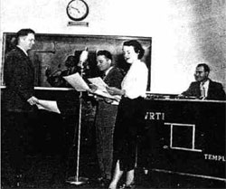
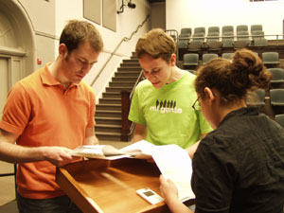
The Difference Tools Make
Surprise — Students started taking over control of course content
  Students collected and created primary source materials of cultural settings, conducted interviews of experts
  Produced podcasts and audioblogs that were linked and downloadable from course web sites
  "Radio: The Theater of the Mind" course produced several audio theater dramas and created website based on old radio shows
    web.duke.edu/~dhfoster/mp3ater.htm
    www.thetheaterofthemind.com/index.htm
Learners in 2010 sum

Slide 40

Sharing of Course Projects
Consistency in a task model or requirements combined with…
  Creative work with flexible “sharing and presentation” strategies
  Encourage a range of project “reports” from podcasts, blogs, wikis, journals, interviews, etc.
  Work that can be shared with a blog, wiki, or service…let the work go “beyond the course”
The task is assessed with a set of suitable rubrics and measures
2011

Slide 41
Assessments in Practice
Design creative work that flows forward to future, to community, to others…
Podcasts, video clips, narrated slideshows, interviews, websites, live and recorded presentations and Q&A
Also think Flickr, YouTube, VoiceThread, SlideShare

Slide 42

Assessment – A focus on growth not grading
Assessment Tip One:
Design in multiple points of assessment
Assessment is forward-looking on learning and developing expertise

Slide 43

Assessment that goes “beyond the course”
Assessment Tip:
Design a task model with flexible sharing that goes “beyond the course”
Shift assessment from testing to creating

Slide 44
Summary Guideline for Authentic Learning
"Place the learner firmly at the centre of the learning experience, encourage him or her to take an active role, and make sure that the learning situation is not abstracted from reality, but is placed directly in a real-world context, either physically or virtually."
Galarneau, 2005. Authentic Learning Experiences Through Play: Games, Simulations and the Construction of Knowledge

Slide 45
Multi-phased customized projects
  Proposal phase
  Milestone phase – outline, design, plans
  Presentation, sharing phase
  Project submitted and archived to portfolio

Slide 46
Assessment vs. Testing
Assessment is multidimensional, holistic and judgmental, forward-looking
Challenge is to design rich, non-specific task models
  Models are open, public and transferable
Testing is "de-contextualized" and specific
  Tests need to be secret and hidden…
Encourages collaboration, supportive learning community

Slide 47

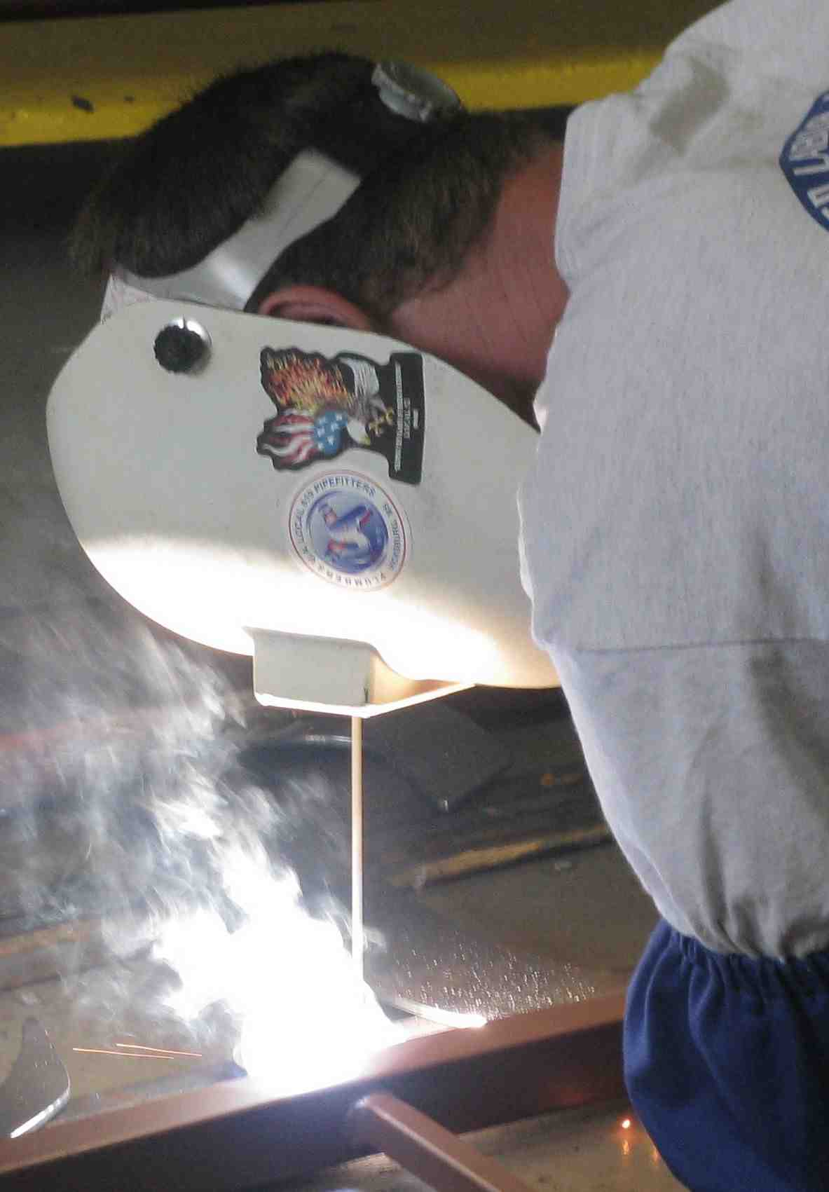
Designing for Adult Learners
Storytelling works!
Hands-on works!
What works to motivate and engage learners?
What does not…

Slide 48
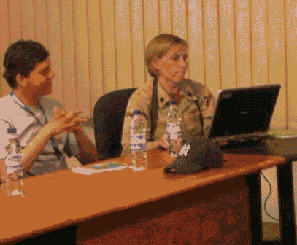
Engaging and Motivating Learners - What Works
Content and experiences that “make sense” to the learner
  Content that “touches on” and links to learner’s existing knowledge base
  Content that is contextualized and situated in meaningful, understandable experiences
  Experiences that look forward to building skills and competencies
    “I can see how /why this is important.” “Wow, I wish I had had this tool/knowledge/understanding back when…
Flexibility and customization of course goals and requirements

Slide 49
What Doesn’t Work
Content that is abstract, formal, uncontextualized; not situated in a time and place and purpose
  Experiences that are “distant” from the learners
  Experiences that are not part of learners’ zones of proximal development (Vygotsky, 1978)
  “Invisible” authors and writers (Clark & Mayer, 2006)
  Share process of discovery learning
Course requirements that are just requirements and are not perceived as learning experiences
  Papers, postings and tests that do not include community or opportunity for revision and growth

Slide 50
Personalizing and customizing tips
Power of immersion suggests… moving quickly to “being, doing, creating, deciding, evaluating, judging”
Enabling, supporting learners’ individual visions of usefulness of knowledge

Slide 51
Customizing Learning
Each brain is its own world… (Adapted Mexican Proverb)
Customizing learning means designing learning experiences for the learner. To do this we need to know the learner and what the learner knows and thinks.

Slide 52
Choices are focused towards applying and using knowledge for personal interests and sharing the results
“I would really like to focus on leadership in the experiences of an IT CEO. “
Blogging from a set of 32 books; selecting from scenarios
Customizing Tip One:
Design a course with built-in content choices for learners
2011

Slide 53
Each learner experiences the course differently – based on their incoming knowledge and goals
Customizing Tip Two:
Design for common, shared and core experiences
that form the basis for community and dialogue
But with shared elements and creating as they learn…

Slide 54
Customized and Personalized Learning
Essential design practice
  Grounded in Vygotsky’s Zone of Proximal Development
    State of readiness for meaningful concept development
    Based in authentic and purposeful learning
  Supplements and enhances
    Professional interests
    Personal development
Shape the course content to learner’s interests and readiness
54

Slide 55
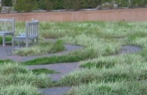
Summary
Design makes a difference in engaging learners and helping them to learn at their zones of proximal development for their life purposes
Learners’ brains — and lives — are as unique as their DNA
Design for creating and growing
Many paths and choices opens possibilities!
2011

Slide 56
Conclusion
Very Important Guideline
In course design, we design for the probable, expected learner; in course delivery, we flex the design to the specific, particular learners within a course.
2011

Slide 57
Questions comments really really wonderful Ideas?
Wrap up of Collaboration Strategies

Slide 58
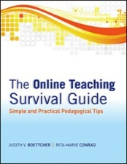
Judith V Boettcher
Author, Consultant, Speaker
Designing for Learning
University of Florida judith@designingforlearning.org jboettcher@comcast.net www.designingforlearning.info
The Online Teaching Survival Guide: Simple and Practical Pedagogical Tips
by Judith V. Boettcher and Rita-Marie Conrad
2011

Slide 59
Appendix Slides

Slide 60
Creating and Using Rubrics
What are rubrics?
Types of rubrics
Scoring criteria and examples
Why rubrics are of such value!
Lots of tips about rubrics in the book and on website

Slide 61
What is a Rubric?
A set of performance criteria for assessing student’s work
  Rubrics often describe four or five levels of performance and the criteria behind each levels
  Rubrics are useful in assessing complex products, such as discussion board postings, projects, papers, and presentations
  Rubrics are "descriptive scoring schemes …to guide the analysis of the products or processes of students' efforts" (Brookhart, 1999, as cited in Moskal, 2000)

Slide 62
Online Discussion Rubric
history.boisestate.edu/westciv/admin/rubricdiscussion.shtml

Slide 63
Online Discussion Rubric
history.boisestate.edu/westciv/admin/rubricdiscussion.shtml
Notes:
If they do everything required..-- this means a certain basic set of knowledge and skills set development, They get a B..
IF they go beyond in supporting other students, leading, channeling and inspiring the discussion.. And have a great project, they get an A

Slide 64
Samples of Rubrics
Humanities
    Book Review (Miami University)
    Classics (Miami University)
    Drama (Miami University)
    English (Miami University)
    Humanities and the Arts (Minnesota State)
    Narrative Essay (Maricopa)
    Philosophy and Religion (Buena Vista)
Sciences
    Physics (University of Virginia)
    Science Lab (National Health Museum)
Social Sciences
    Anthropology (Miami University)
www.web.virginia.edu/iaas/assessment/assessrubrics.htm#samples

Slide 65
Rubrics – Expectations for Creative Learner Expressions
Good Resource Summary for Rubric Samples
    http://course1.winona.edu/shatfield/air/rubrics.htm
      Susan Hatfield, Professor, Communication Studies Winona State University
Sample rubrics available online
    Podcast
    Wikis
    Discussion boards
    Reflective paper
    Blogs

Slide 66
Rubrics – Samples from Winona Site
Online Discussion - George Mason
    http://mason.gmu.edu/~ndabbagh/wblg/online-protocol.html
Discussion - Boise State
    E. L. Skip Knox History of Western Civilization
      http://www.boisestate.edu/courses/westciv/admin/rubricdiscussion.shtml
Ethics Case - Penn State
    http://www.personal.psu.edu/faculty/d/x/dxm12/n458/sample_case_rubric.htm
Strategic Mgmt Case - St. Scholastica
    http://faculty.css.edu/dsurges/ASSESSMENT/mgt6700-rubricstrategycase.html
Classic Math Rubric
    http://www.exemplars.com/resources/rubrics/classic.html

Slide 67
Steps in Creating Rubrics
Gather sample rubrics
Brainstorm the types of evidence that demonstrates the learning outcome(s) you are assessing
Keep the list of types of evidence to 3-8 items, focusing on the most important abilities, knowledge, or attitudes desired
Edit the list so that each item is specific and concrete, use action verbs when possible, and descriptive, meaningful adjectives
Assign values to varying levels of competence or skill
Test the rubric by scoring a small sample of student work
Helps students go beyond reading, listening to doing, evaluating, creating, judging
Adapted from www.web.virginia.edu/iaas/assessment/assessrubrics.htm

Slide 68
Problem Solving
Problem solving is the process of designing, evaluating and implementing a strategy to answer an open-ended question or achieve a desired goal.
More in handout
Example of Rubric from AACU Site
“nationally shared set of meanings around student learning

Slide 69
Problem-Solving Rubric - AACU
Skill Elements
Capstone 4 Skill
Define problem
Identify strategies
Propose solutions/hypotheses
Evaluate potential solutions
Implement solution
Evaluate outcomes
Demonstrates the ability to construct a clear and insightful problem statement with evidence of all relevant contextual factors.
Evaluation of solutions is deep and elegant (for example, contains thorough and insightful explanation) and includes, deeply and thoroughly, all of the following: considers history of problem, reviews logic/reasoning, examines feasibility of solution, and weighs impacts of solution.
http://www.aacu.org/value/rubrics/pdf/ProblemSolving.pdf

Slide 70
"An authentic assessment system has to be based on known, clear, public, nonarbitrary standards and criteria."
G. Wiggins, 1993. Assessing Student Performance, p. 51

Slide 71
Nine Reasons You and Your Learners will like Rubrics
Help clarify vague, fuzzy goals
Help students understand your expectations
Help students self-improve
Inspire better student performance
Make scoring easier and faster
Makes scoring more accurate, unbiased, and consistent
Improve feedback to students
Reduce arguments with students
Improve feedback to faculty and staff
Suskie, L. (2009) Assessing Student Learning, 2ed

Slide 72
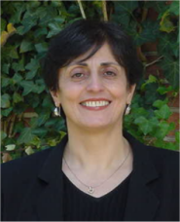

Continuous Assessment Model
Continuous Assessment Model (Moallem, 2004)
  Student-centered
  Performance-based
  Process-based
Includes metacognition of and by learners
Mahnez Moallem
Patricia Comeaux
Notes:
.

Slide 73
Continuous Assessment Model
Self-Assessment
Assessment from
Expert
Performance, Process
And Progress-based
Assessment
Assessment from Peers
Moallem, 2005

Slide 74
Continuous Assessment Model - How to…
Design a course with a minimum of three major assessment points for complex projects
  Initial proposal for project
  Progress assessment
  Project sharing, presentation
  Project submission and saving to portfolio
At each stage, design in three types of feedback
  Self, expert and peer…
  Provide checklists, rubrics, examples

Slide 75
Five Elements of Successful Cooperative Learning Groups
Positive interdependence
  Success of individuals linked to success of the group
Promotive interaction
  Members share resources, support and encourage each other
Individual and group accountability
  Group is accountable; students are also assessed individually
Develop team work skills along with task content
  Learners acquire knowledge and skill and team skills
Group processing
  Learners learn how to evaluate and improve work group skills
Johnson, Johnson and Smith (1998)

Slide 76
Self-regulation of Learning
Self-efficacy
  Learners’ belief that they have the ability to organize and execute actions necessary to attain specific goals (Bandura, 1997)
Outcome expectations
  Learners’ belief that their course of action will result in the attainment of desirable outcomes (Bandura, 1997)
Intrinsic/extrinsic interest
  Learners’ enjoyment of participating in a task for the sake of learning; learners’ engagement in the task for other reasons Schunk, Pintrich, and Meece, (2008)
Future time perspective
  Learner’s perception of how far off in the future the rewards are (Zimmerman 2000)
Effort regulation
  Ability to focus, and use resources, energy and time to learn
Bembenutty (2011) Self-regulated Learning

